Slide 1
Extracting Insights from Hotels on Booking.com
Group #9

Slide 2

Dataset Introduction
The dataset extracted using web scraping from Booking.com contains the following features:
Name, Price, Rating, Review Title, Review Count, Distance, Beds, Room Type, Sustainable, Cancellation, City, Staff, Facilities, Cleanliness, Comfort, Value for Money, Location, Free WiFi.
The dataset scraped contains a total of 1054 rows of unique hotels, villas and apartments with 18 columns of the above mentioned features.

Slide 3

Machine Learning
After cleaning the dataset we decided to fit Machine Learning models to predict the hotel prices within a certain accuracy.
As discussed in the first blog report we focus on the Client and Managerial sides in such a way that allows us to tell a client what price they should be expecting for a hotel based on their preferences and to managers about the expected price of their hotels.
These insights can be used by managers for gauging which feature to focus on if they want to maximize the profit in context of Pakistan and for clients to see if they are getting fair prices on accommodations or not.

Slide 4
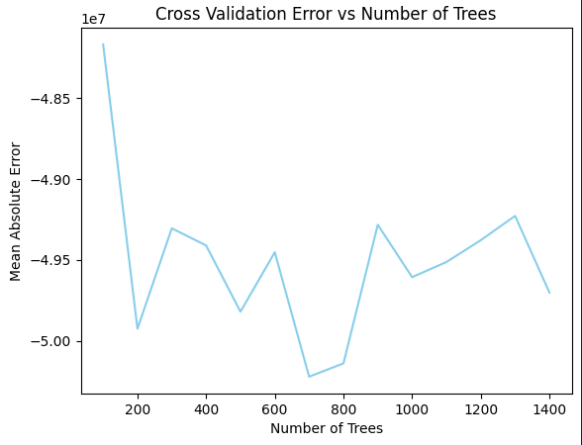
Client Side
The first step is to fit a model that clients can utilize by inputting their expected feature ranges. For this purpose we made use of Random Forest Regressors from the Sklearn library.
Using Cross Validation we ran the model on a range of estimators to see at which point we obtained the lowest cumulative Mean Absolute Error.
From the graph it is visible that this is around 700 so that is the number of estimators that we will be using for predictions in the client’s case.

Slide 5
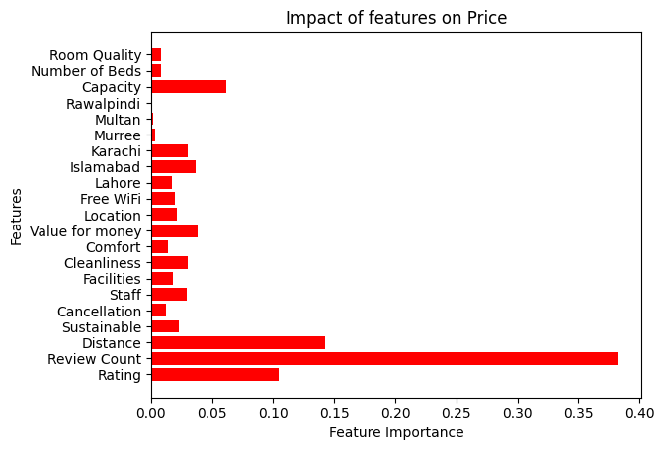
Impact on Price
From the graph on the left it is visible that Distance from the Center, Review Count and Rating are the features with the most importance.
This can be explained as the closer the Hotel is to the center of the city, the more guests it can expect. This can be inferred from the fact that guests tend to stay in places that are closer to the important facilities.
Review Count is also an important metric since guests that are generally satisfied are the ones that tend to leave reviews meaning that high review counts can indicate better accommodations.
Lastly the Rating is an explanatory variable since higher ratings mean that the hotels are generally better and guests had a pleasant experience while staying in them.

Slide 6
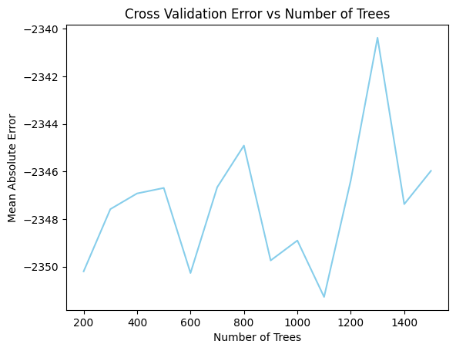
Managerial Side
Similar to the client side performing cross validation yielded 110 estimators as the best parameter for lowering the Mean Absolute Loss.
With this in mind the Pseudo Profit can be used to check which features impact the Net Profit the most.
One key realization to keep in mind with these visualizations is that a single value of feature importance alone can never be enough to model this problem fully since we can not improvise on a single feature and keep generating profits.

Slide 7
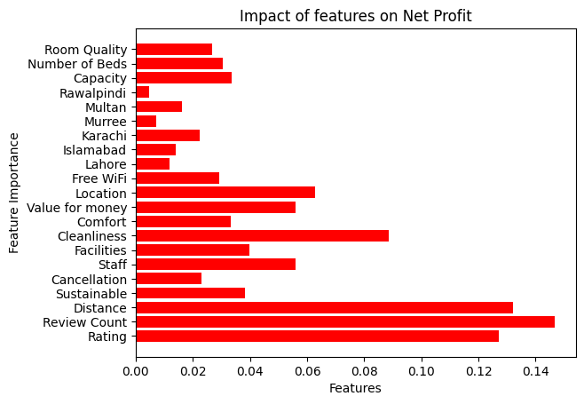
Feature Impacts on Net Profit
By fitting the model we can observe that the Distance from the Center, Review Count and Rating are once again the most important features. This time however these are importances are based on the Net Profit which is of use to managers.
An interesting insight here is that Review Count and Ratings are features that are updated once guests are done with their travels. For potential Hotel managers their best bet would be to focus on Distance, Cleanliness, Location, Value for Money and Staff features since these have a significant impact on the Net Profit and can subsequently help to improve Review Count and Ratings which can drive up the Net Profit even more.

Slide 8


Conclusion
Real-world Dynamics:
Acknowledging feature impact limitations mirrors real-world industry dynamics.
Modeling net profit distribution provides a nuanced perspective.
Future Work:
Recognizing limitations guides future improvements in data collection and modeling.
Exploration of more sophisticated models for non-linear relationships is an opportunity.
Practical Applicability:
Despite limitations, our visualizations offer invaluable insights for newcomers in the Pakistan hotel business.
Strategic decisions on feature enhancements, cost management, and overall business strategies can be guided effectively.
Nuanced understanding from our analysis provides a foundation for informed and strategic decision-making.
Leveraging these insights enables newcomers to navigate the dynamic hospitality landscape more effectively.
Enhances chances of success by fostering informed and strategic decision-making.

